Slide 1
Routing…

Slide 2
What is routing?
It is the way in which the routers makes the decision of where to send the information or data.
It is a process which is performed by layer 3 (or network layer) devices in order to deliver the packet by choosing an optimal path from one network to another.

Slide 3
Why Routing?
The routing function in the network is a method of information forwarding to the correct destination through network connection data.
The need network routing is to be able to connect two different networks together.
It allows us to reuse the local ip address through different network

Slide 4
Techniques of routing..
Forwarding a message to one or more receiver systems
Forwarding a message to different inbound interfaces of a receiver.
Dividing a message into multiple sub messages.

Slide 5
Types of routing..
There are three types of routing:
Static Routing
Dynamic routing
Default routing

Slide 6
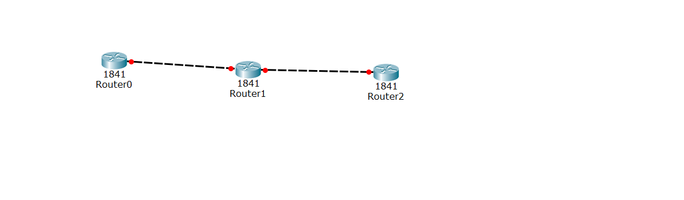
Static Routing
The routing in which routing table is created, maintained and updated by a network manually.
In short, Static routing is a process in which we have to manually add routes in routing table i.e. point to point connectivity.

Slide 7
Advantages of static routing
No routing overhead for router CPU which means a cheaper router can be used to do routing.
It adds security because only administrator can allow routing to particular networks only.
No bandwidth usage between routers.

Slide 8
Disadvantages of static routing
For a large network, it is a hectic task for administrator to manually add each route for the network in the routing table on each router.
The administrator should have good knowledge of the topology. If a new administrator comes, then he has to manually add each route so he should have very good knowledge of the routes of the topology.

Slide 9
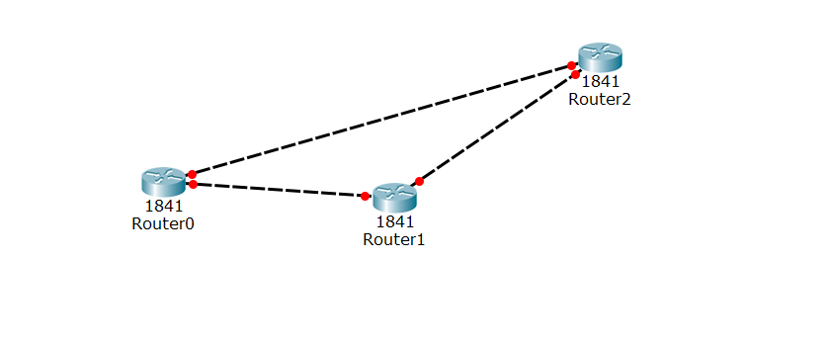
Dynamic Routing
The routing in which routing table is created, maintained and updated by routing Protocol running on the router and it can connect to any devices.
Dynamic routing makes automatic adjustment of the routes according to the current state of the route in the routing table (which means automatic adjustment will be made to reach the network destination if one route goes down).

Slide 10
Features of Dynamic Routing..
The routers should have the same dynamic protocol running in order to exchange routes.
When a router finds a change in the topology then router advertises it to all other routers.

Slide 11
Advantages of Dynamic Protocol
Easy to configure.
More effective at selecting the best route to a destination remote network and also for discovering remote network.

Slide 12
Disadvantages of Dynamic Protocol
Consumes more bandwidth for communicating with other neighbors.
Less secure than static routing.

Slide 13
Default routing…
It is the method where the router is configured to send all packets towards a single router and default routing protocol.
It doesn’t matter to which network the packet belongs, it is forwarded out to router which is configured for default routing.

Slide 14
Types of Routing Protocol…
Internal gateway Protocol(IGP)
External gateway Protocol(EGP)

Slide 15
Continued…
IGP is the one of the routing protocol works with single autonomous system.
For Example : Router within a small area like office.
EGP router are the one which are connected over internet.

Slide 16
Continued…
IGP are further classified into:
RIP
OSPF
EIGRP
EGP are classified into:
BGP
EGP

Slide 17
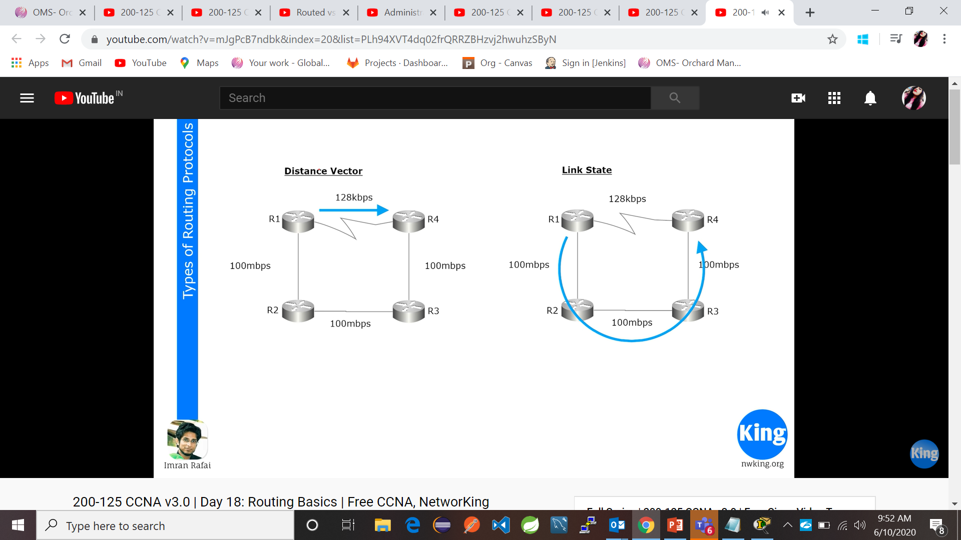
Distance Vector…
Distance Vector: This is the protocol which looks only the distance means the shortest path among the networks.
It does not bother about the slow connectivity over the networks
Route Information protocol(RIP) follows the dynamic vector.

Slide 18
LinkState…
Linked State looks upon the fastest networks available.
It follows OSPF protocol(Open Shortest Path First Protocol)
EIGRP is only used by cisco domain and it more efficient than RIP or OSPF protocol. It is a hybrid protocol.

Slide 19
BGP & EPG
Border Gateway Protocol is protocol that manages how packets are routed across the internet through the exchange of routing and reachability information between edge routers.
It is a layer 4 protocol and is used for exchanging routing information.
Exterior Gateway Protocol is a protocol for exchanging routing information between two neighbor gateway hosts (each with its own router) in a network of autonomous systems.
EGP is commonly used between hosts on the Internet to exchange routing table information.

Slide 20
Features of CISCO Routers..
It provides the secure WAN Connectivity with desktop and are used by large networked companies, high scales companies.
It provides Speed with secure data for cable, Ethernet, WAN environment etc.
Cisco Express Forwarding Enhanced

Slide 21
Route Information Protocol (RIP)
RIP Was developed in 1969.
The Routing Information Protocol (RIP) is one of the old distance vector routing protocol.
RIP prevents routing loops by implementing a limit on the number of hops allowed in a path from source to destination.
The largest number of hops allowed for RIP is 15, which limits the size of networks that RIP can support.

Slide 22
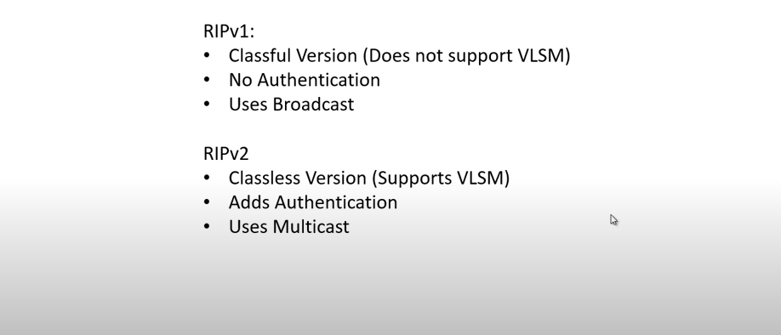
Version Of RIP
RIPV1
RIPV2

Slide 23
Advantages of RIPV1
Easy to configure, static router are complex.
Less overhead
No complexity.

Slide 24
Disadvantages of RIPV1
Bandwidth utilization is very high as broadcast for every 30 seconds.
It works only on hop count.
It is not scalable as hop count is only 15. If there will be requirement of more routers in the network it would be a problem .
Convergence is very slow, wastes a lot of time in finding alternate path.

Slide 25
Advantages of RIPV2
It’s a standardized protocol.
It’s VLSM compliant.
Provides fast convergence.
It sends triggered updates when the network changes.
Works with snapshot routing – making it ideal for dial networks

Slide 26
Disadvantages of RIPV2
Max hopcount of 15, due to the ‘count-to-infinity’ vulnerability.
No concept of neighbours.
Exchanges entire table with all neighbours every 30 seconds

Slide 27
Timers of RIP
There are Four types of timers:
Update Timer(30)
Invalid Timer(180)
HoldDown Timer(180)
Flush Timer(240)

Slide 28
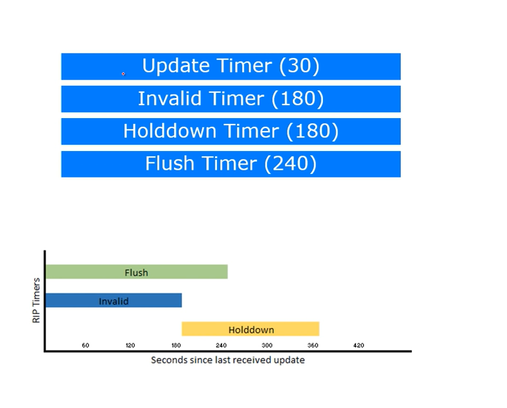
Continued….

Slide 29
Limitation of RIP..
Increased network Traffic
Maximum Hop count
Problem with distance vector
It only updates the neighbors and the update for non neighboring router should not get any information about anything like data flow. etc.

Slide 30
Administrative Distance(AD)
Administrative distance is the feature that routers use in order to select the best path when there are two or more different routes to the same destination from two different routing protocols.
Administrative distance defines the reliability of a routing protocol.

Slide 31
Routing Decision
It is taken by longest prefix length
Administrative Distance(AD) of Routing Protocol

Slide 32
Routed Protocol
Routing Protocol fits in the Network Layer(Layer 3) of OSI Model
It can be used to carry the information from sender to receiver and it is available in every device in the network
For Example : IP,Apple,Talk,Ipx

Slide 33
Routing Protocol
A routing protocol learns to route and sends routes for a routed protocols.
The information are sent immediately when router are available/unavailable
It defines the best path for sending the data
For Example: RIP,BGP,EIGRP,EGP

